Slide 1
Credit Card Fraud Detection
By: Christian Hernandez Campos, Kaushik Basavaraju

Slide 2
Project Summary
We wanted to detect whether a transaction is Fradulent or non Fradulent. Containing a logistic regression model and a neural network model for credit card fraud detection. The models are designed to analyze credit card transactions and predict whether a transaction is fraudulent or legitimate. It is trained on a labeled dataset from kaggle of historical credit card transactions, where each transaction is labeled as either "fraud" or "non-fraud."

Slide 3
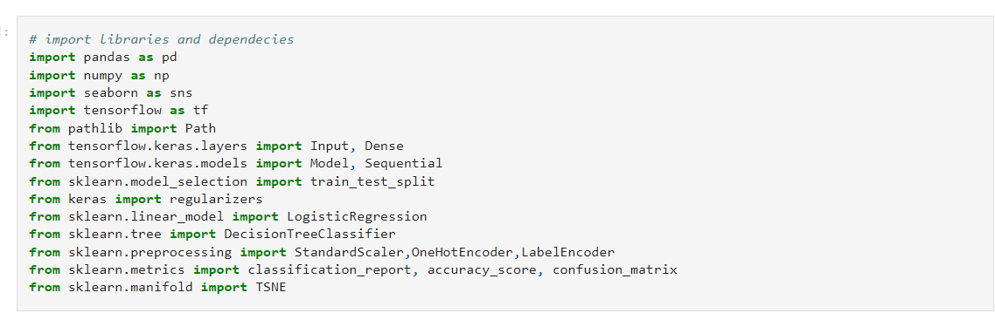
Technologies
Installations/Imports:
Data:
Kaggle:
User0_credit_card_transactions.csv
sd254_cards.csv
Sd254_users.csv
Programming Language: Python using Jupyter Lab

Slide 4
Neural Network Model - Steps
Read data from .csv files into dataframes
Data Cleanup/Adjustments:
Converting ‘Amount’ to float
Use ‘Label encoder’ and ‘one hot encoder’ to convert categorical data into numerical format
Establish Features and Target data (all categories, Is Fraud?)
Use oversampling method due to imbalance of dataset
NN Model:
When Properly Trained and optimized, neural network models can achieve high accuracy in detecting fraudulent transactions. They can significantly reduce false positives and false negatives, thus improving the overall performance of fraud detection systems. Real time detecting can also be achieved with further advancements in the model as it can keep adapting

Slide 5
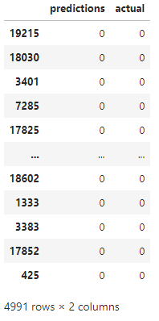
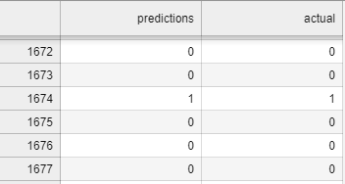
Predictions Results NN

Slide 6
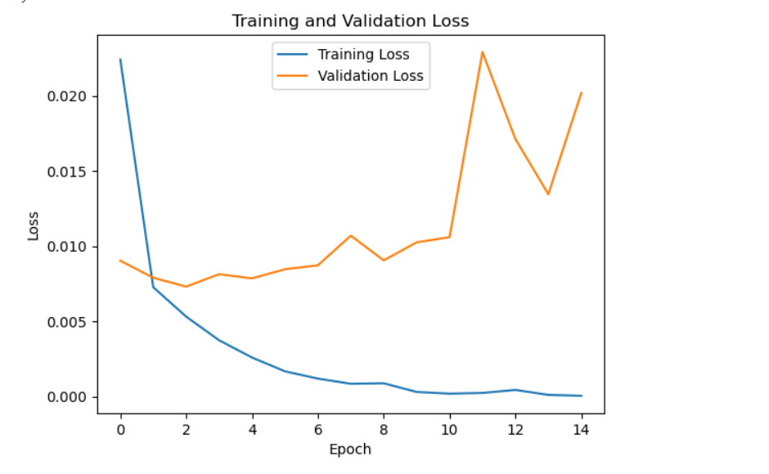
Evaluation Metrics - Training & Validation Loss
Training loss is slight to none
Validation loss is higher but not significant

Slide 7
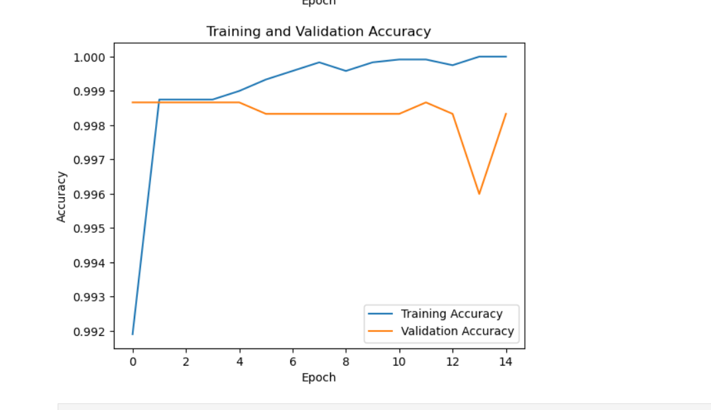
Evaluation Metrics - Training & Validation Accuracy
Training Accuracy is very high with slight dips
Validation accuracy has dip but not significant

Slide 8
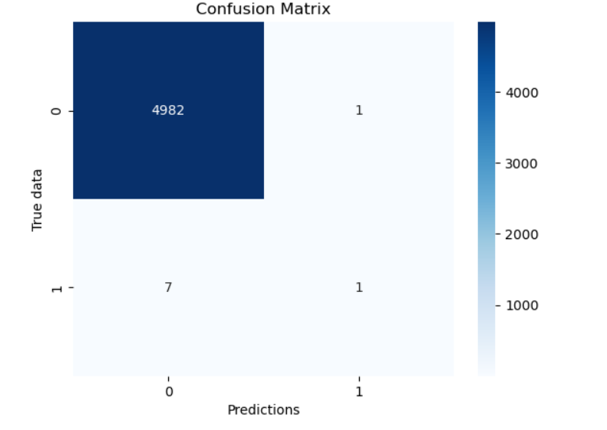
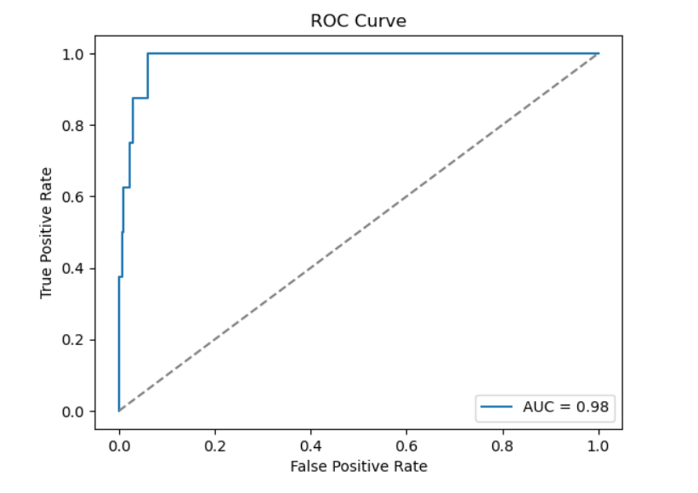
ROC - Curve - NN Model
Almost perfect AUC score
Confusion matrix - NN model

Slide 9
Logistic Regression Model
Read data from .csv files into dataframes
Data Cleanup/Adjustments:
Converting ‘Amount’ to float
Use ‘Label encoder’ and ‘one hot encoder’ to convert categorical data into numerical format
Establish Features and Target data (all categories, Is Fraud?)
Use oversampling method due to imbalance of dataset
Run Logistic Model after establishing training and testing datasets
Run classification reports to evaluate accuracy of model

Slide 10
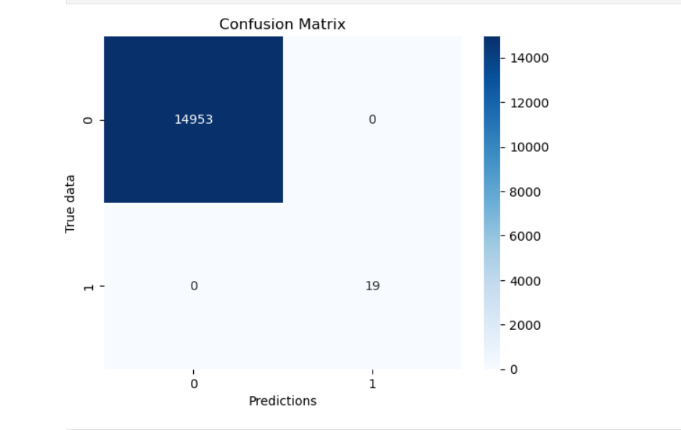
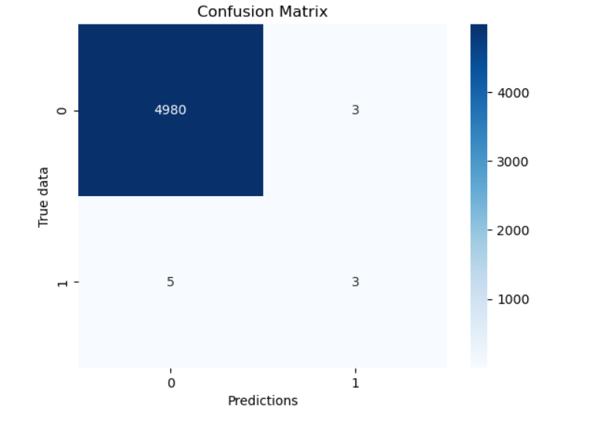
Training vs Testing Confusion Matrices
Training
Testing

Slide 11
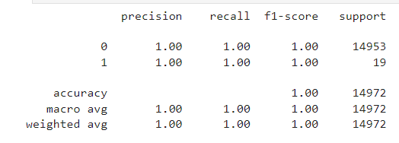
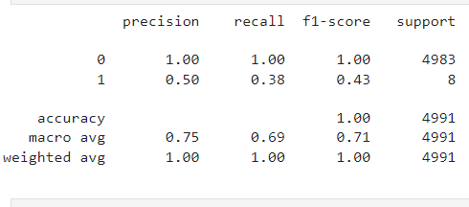
Logistic Regression Classification Report
Testing Classification Report
Training Classification Report

Slide 12
Closing Thoughts
Would like to explore other supervised learning techniques on the data
Ex. SVM, K-means clustering
Drawbacks of neural networks:
Black box - too many features can create disconnect between understanding of weightage each feature and output
Amount of data needed to run neural network models
Drawbacks of logistic regression:
With many features, logistic regression can fall apart in accuracy even though it is easier to interpret; interprets data in a more simplistic manner
Still somewhat susceptible to overfitting
Other challenges:
Validation testing and interpreting the results

